Slide 1
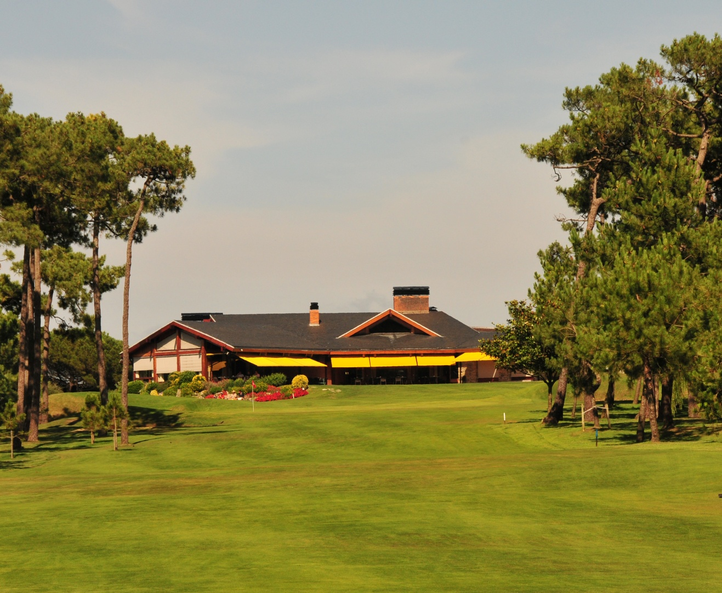








2011
26th & 27th August
Jacques Leglise Trophy
Real Sociedad de Golf de Neguri
Neguri (Vizcaya) – Spain

