Slide 1
Brussels, May 24th by David Gómez Agüera
SUSTAINABILITY

Slide 2


TRANSITION ZONE
Bermudagrass = SUSTAINABILITY
→ Saves water
→ Saves energy
→ Reduce labor

Slide 3
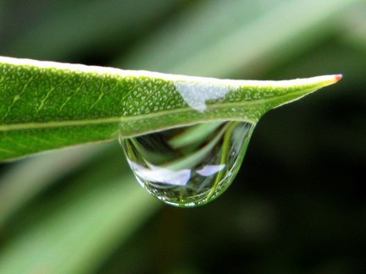
TRANSITION ZONE
Bermudagrass = SUSTAINABILITY
→ Saves water
→ Saves energy
→ Reduce labor

Slide 4
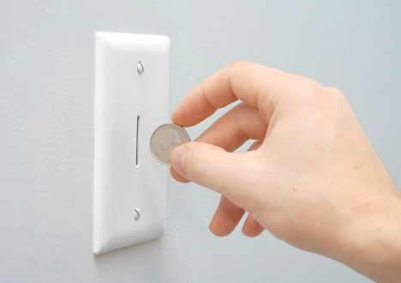
TRANSITION ZONE
Bermudagrass = SUSTAINABILITY
→ Saves water
→ Saves energy
→ Reduce labor

Slide 5

TRANSITION ZONE
Bermudagrass = SUSTAINABILITY
→ Saves water
→ Saves energy
→ Reduces maintenance

Slide 6
Two different classes
EL BONILLO (SPAIN)
Very low budget for the construcction
Pure transicion zone
Very bad soil
Efluent water for irrigation
Only two row of splinker in fairway, three on teeplataform
and four per green
We do not have USGA sand specification for green

Slide 7
Two different classes
EL BONILLO (SPAIN)
 | WARM-SEASON EXPENSES | COOL-SEASON EXPENSES
FERTILIZATION | 9.000,00 € | 13.000,00 €
TOP-DRESSING | 9.000,00 € | 9.000,00 €
IRRIGATION | 3.000,00 € | 3.000,00 €
CHEMICALS | 8.000,00 € | 12.000,00 €
SEEDS | 500,00 € | 2.500,00 €
SPARE PARTS | 8.500,00 € | 10.500,00 €
FUEL | 9.000,00 € | 13.000,00 €
STAFF | 3 | 7
TOTAL | 47.000,00 € | 62.000,00 €

Slide 8
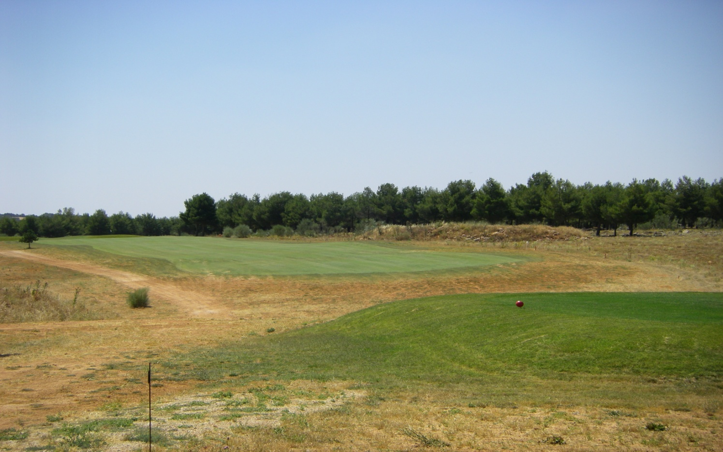
Two different classes
EL BONILLO (SPAIN)

Slide 9
Two different classes
PGA CATALUNYA (SPAIN)- by DAVID BATALLÉ
New method to install through of sprigs from bermudagrass
Transition among species has assumable expenses
Don´t need to close the golf course to do it
Very good conditions for playing

Slide 10
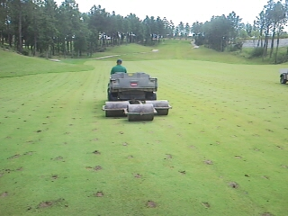
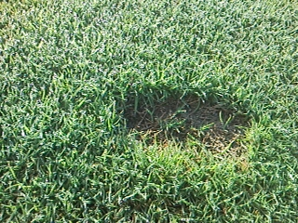
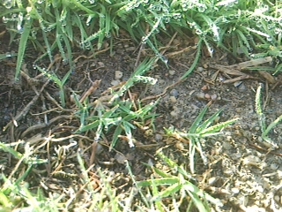
Two different classes
PGA CATALUNYA (SPAIN)- by DAVID BATALLÉ

Slide 11

Thank you for your attention
Any question?
SUSTAINABILITY

