Slide 1
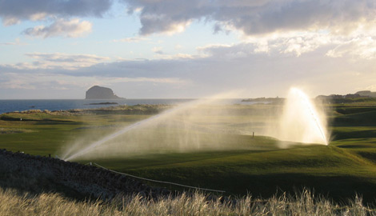
Water Consumption on Golf Courses
EGA GCC January 2012

Slide 2








EGA GCC Position on Water
The EGA GCC is encouraging golf facilities to permanently reduce water consumption by:
  Restricting the area of turf and utilising native vegetation in golf course design
  Investing in methods of on-site water collection and storage and using recycled water for irrigation
  Investing in efficient irrigation systems

Slide 3
EGA GCC Communications on
Water and Golf
  Using the free advice on The R&A website
  http://www.randa.org/en/TheGolfCourse.aspx
  Golfer education: images of 2006 Open Champion winner Tiger Woods endorsing the drought-induced condition of Royal Liverpool course show that golf can produce a quality challenge for the golfer whilst adapting to local rainfall. http://www.pga.com/openchampionship/2006/
  The R&A produced a short film, “The Open Road to Sustainability” that focused on the low inputs that went into producing a major championship course.

Slide 4
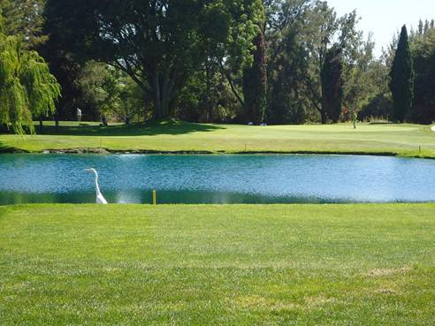
Water Management development
In recent years there has been
more investment in the
management of water, notably
in Southern European Countries.
Golf courses have been:
  Reducing grassed areas and increasing natural areas/ wildlife reserves
  Using more recycled water
  Designing more efficient irrigation systems
  Investing in better technology/ newer technology to water golf courses sustainably, e.g. control systems and sprinkler heads

Slide 5
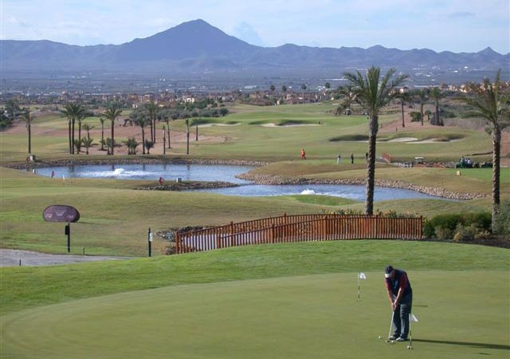
Spain Overview of Water Management
Clubs have developed systems to harvest and store water to be used in irrigation of the golf course
85-100% water is recycled
Spanish clubs have changed the use of turfgrass species to optimise the availability and type of irrigation water
-cut down the grassed area, have expanded the use of native vegetation to compensate for the lack of irrigation water quality
-modified the design of the irrigation system to optimise water conservation

Slide 6
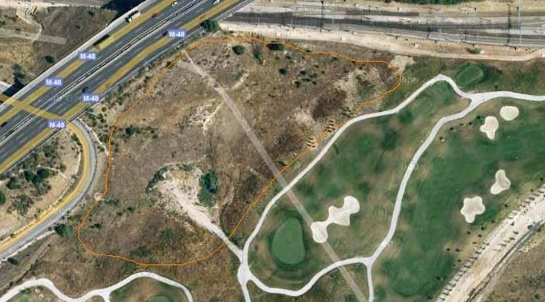
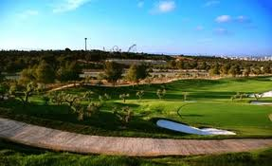
Spain- Water Statistics
Percentage of water used for irrigation that is recycled/reused
Golf Course | Percentage
Arcos Gardens, Cadiz- | 80-85%
Alicante Golf, Alicante | 100%
Son Park, Minorca | 100%
Torremirona, Girona | 100%
Golf Serres de Pals, Girona | 85%
Real Sociedad Hípica Española Club de Campo, Madrid | 50%
Puerta de Hierro, Madrid | from 2012 100% will be watered with reclaimed water

Slide 7
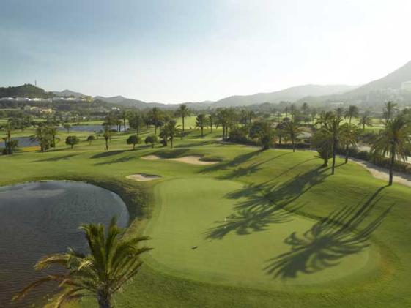
Spain - Case Study (La Manga)
The La Manga Club resort in Spain has seen significant reductions to both its energy consumption and water
usage after implementing an environmental management plan.
Before | After
High energy consumption | Solar power now provides 30-40 % of the energy required for hot water
High water consumption | -Introduction of aerators, flow control and timer mechanisms on taps, leading to a 60% reduction in water -70% of water is recycled from a wastewater treatment plant

Slide 8
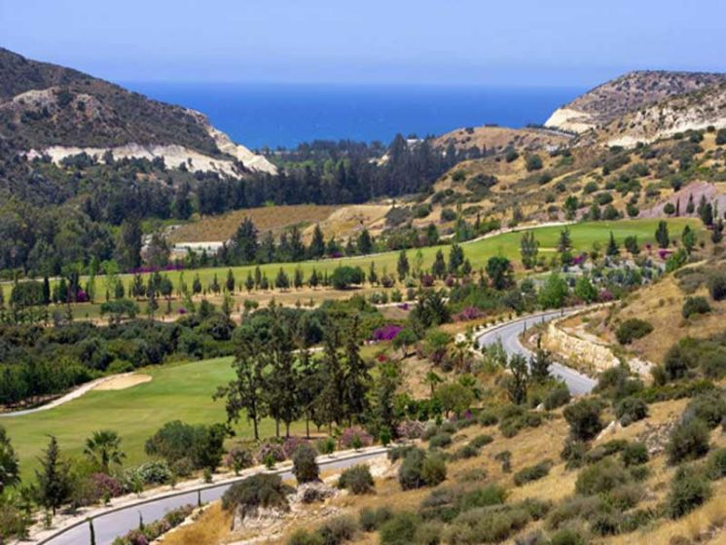
Cyprus Overview of Water Management
Clubs use rain and drainage water harvesting
They use grey water coming from resort treatment plants
They have changed the grass from Ryegrass in greens surrounds and Bentgrass on tee tops to Bermudagrass (Tifton 419) in order to reduce the water need
They have acquired better technology for irrigation

Slide 9
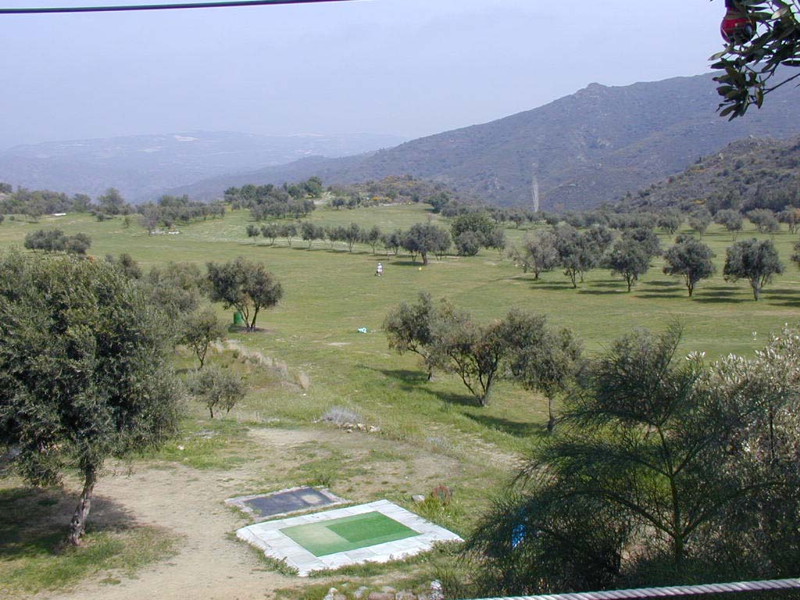
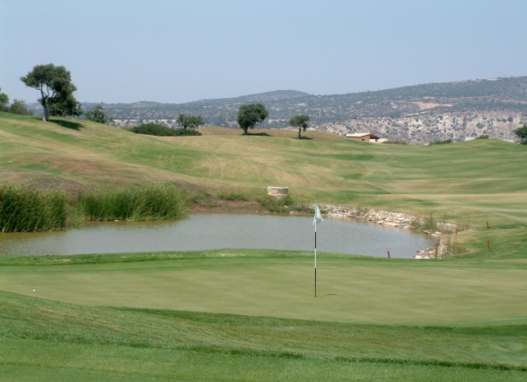
Cyprus – Case Study (Aphrodite Hills)
Since 2008’s droughts and environmental concerns the club has extensively reduced their
irrigation water consumption
Before | After
Green grassed areas | Natural areas with native vegetation
Old irrigation systems | -Changed sprinklers from full circle to part circle -Corrected distances between sprinklers to improve performance -Changed nozzles to improve performance -Leveled sprinklers to improve performance fixing leaks constantly to avoid losses

Slide 10

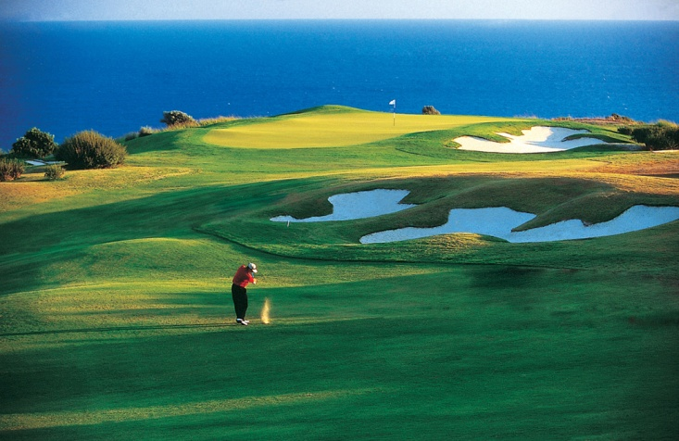
Cyprus – Case Study (Aphrodite Hills)
They invested on a spoon feeding program for the entire golf course throughout the summer months that helps to keep the grass healthy so it is more efficient in the water use
They ran an acid injection system that can reduce the water pH to the desired level of 6,5-7,0 that helps the grass tremendously to use water more efficiently
Every year, they “flush” greens, tees and fairways in order to wash the accumulated salts in the soil profile

Slide 11
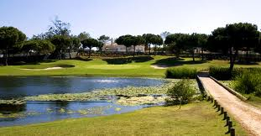
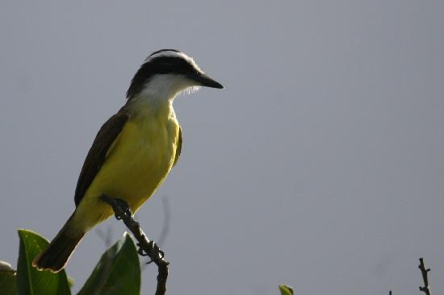
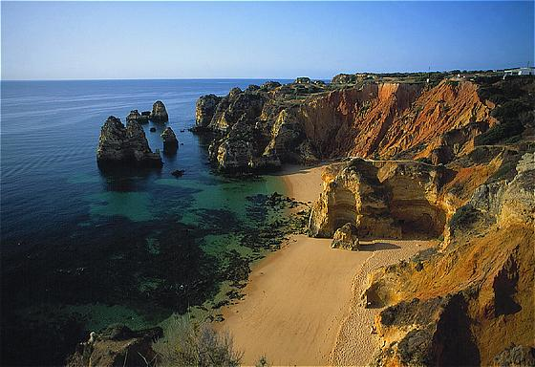
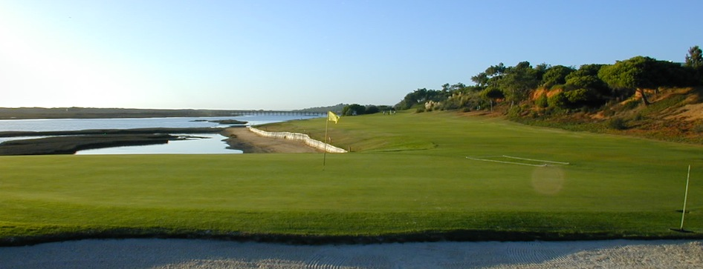
Portugal Overview of Water Management
They select grass that reduces water consumption
They use warm-season species: the use of warm-season species has allowed them to reduce the total annual water consumption and the energy consumption for water supply and for running the irrigation system by up to 50%
They invest in irrigation technology

Slide 12
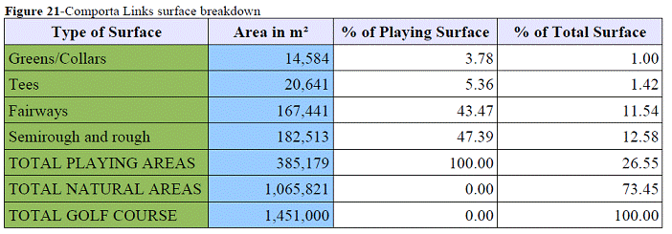
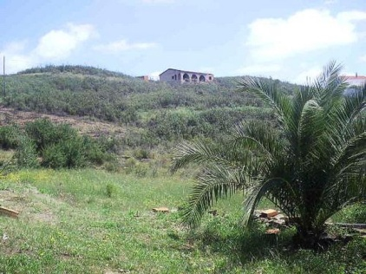
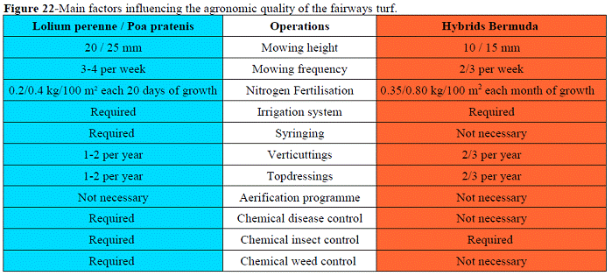
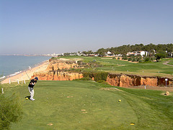
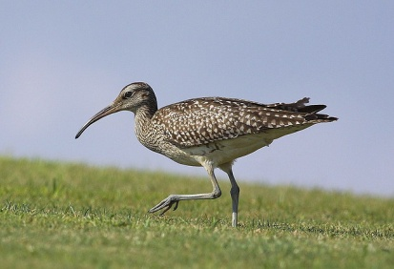
Portugal- Case Study
(Comporta Links Golf Course )
This is a cutting edge project focused on water conservation and it was a Candidate venue for the 2018 Ryder Cup
The club is designed to conserve water by:

Slide 13
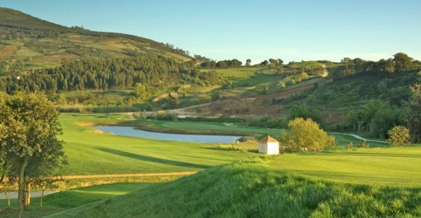
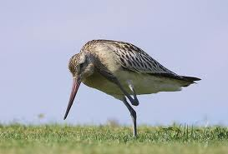
Portugal- Water Statistics
(Campo Real)
Before – no irrigation management | After – irrigation management in place
Total year - 203,421.2m3 | Total year - 165,651.5m3
Total July - 47,676.5m3 | Total July - 35,112.5m3
Peak day - 1,567.7m3 | Peak day- 1,132.7m3
Percent reduction with irrigation management
Total year – 18.57% Total July – 26.35% Peak day – 27.75%

Slide 14
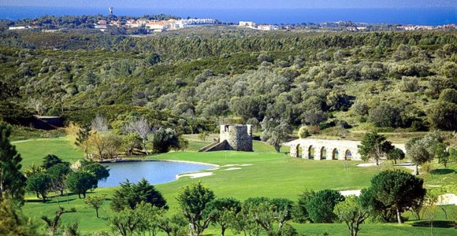
Portugal- Water Statistics
(Penha Longa)
TURF REDUCTION - Reduction of irrigated area in 15 Ha (37 Acres)
Before | 65.7 ha
After turf reduction | 50.7 ha
Water Supply
Total water supply - wet year | 800,000.00 m3
Total water supply - dry year | 500,000.00m3
Water Use | Before | Forecasted After
Peak day | 3,809 | 2,500m3
Month | 118,085 | 77,500m3
Year | 545,341 | 358,000m3
A 34% annual reduction is forecast.

